Slide 1
CLT Development Center 2026 Update

Slide 2
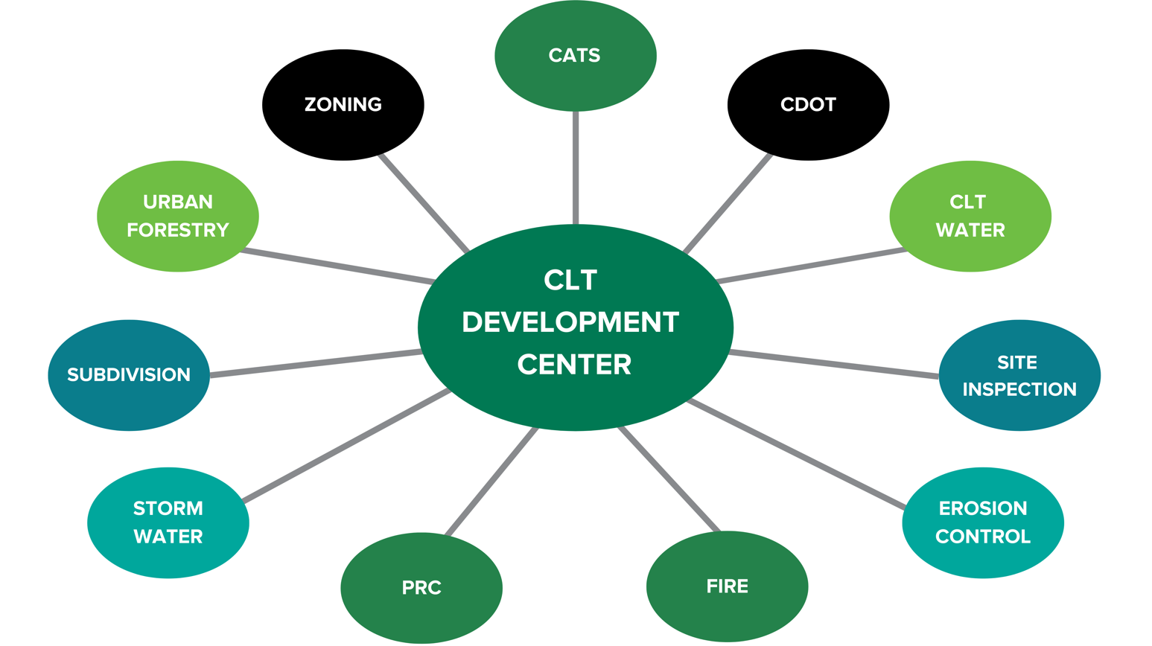
CLT Development Center
Planning, Design and Development: Construction Inspection, Subdivision, Zoning, Plan Review Coordinators, Urban Forestry
Stormwater/Engineering: Engineering, Erosion Control
CDOT
Charlotte Water
Fire
CATS

Slide 3
What is Reviewed in Charlotte and in Mecklenburg County?
Residential/Commercial Land Development Construction & Building Plans
Individual Residential Lots (IRL) & Building Permits

Slide 4
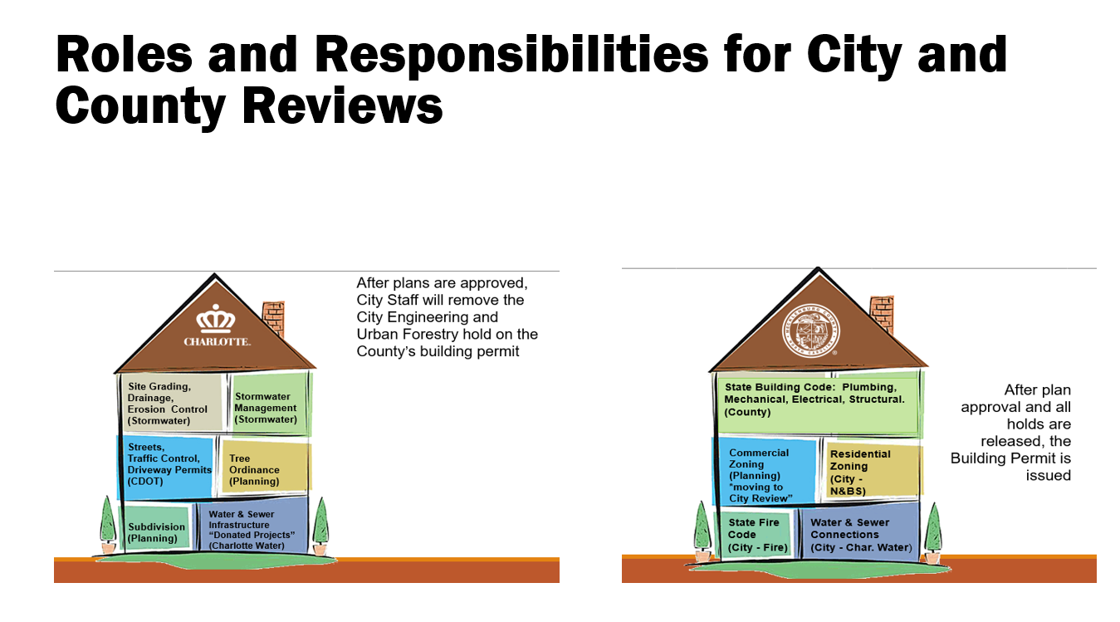
Engaging the audience
Make eye contact with your audience to create a sense of intimacy and involvement
Weave relatable stories into your presentation using narratives that make your message memorable and impactful
Encourage questions and provide thoughtful responses to enhance audience participation
Use live polls or surveys to gather audience opinions, promoting engagement and making sure the audience feel involved

Slide 5
Residential Permitting

Slide 6
Key Change: The UDO and The Residential Permitting Process
Pre -UDO
Stormwater and Urban Forestry staff did not review individual residential permits.
The Residential Zoning review was completed at Mecklenburg County on the building permit submittal.
Post-UDO Implementation
Stormwater and Urban Forestry review residential permits.
The City created a review process – Land Development Individual Residential Lot application (LDIRL).
Residential zoning is incorporated into LDIRL reviews.
Residential team moved to CLT Development Center 10/2024.
UDO Compliance (Stormwater/Urban/Forestry) is reviewed and approved by City staff prior to permit issuance by Mecklenburg County.

Slide 7
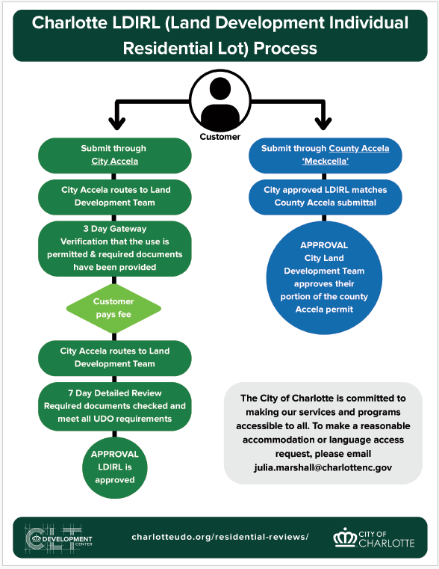

Slide 8
Reorganization of Planning’s Land Development Teams

Slide 9
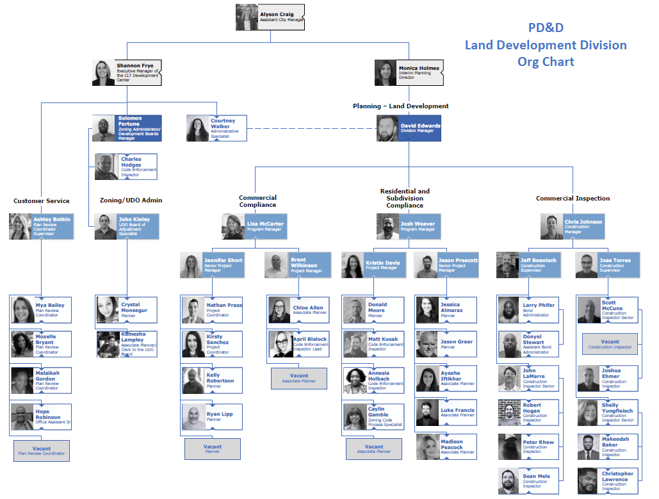
Reorganization of Team
We are reorganizing the unit to better align our structure with the work we do and the needs of our customers and stakeholders. The goals of this change are to:
Improve efficiency and reduce bottlenecks so tasks can move more smoothly.
Balance workloads and responsibilities to make the best use of everyone’s strengths.
Enhance communication and collaboration across the team.
Align with organizational priorities and customer needs, ensuring our work supports the larger mission.
Position the unit for future growth and change, giving us flexibility to adapt.
This reorganization is not change for the sake of change—it is a step toward making our work more effective, responsive, and sustainable.

Slide 10
Development Services Technical Advisory Commute (DSTAC) 2.0
Refreshed & Overhauled in Spring 2025
New Charter
New Co-Chairs
New Members

Slide 11

DSTAC
DSTAC serves in an advisory role and provides input on technical and procedural regulatory issues regarding development in Charlotte. This committee serves as a forum for discussing policy and procedural changes or conflicts regarding plan approval, inspection services, and enforcement of land development requirements and provide recommendations, as needed.
19 members who serve one 3-year term (initial term for half of the members is 2 years to allow for a transitional rotation of membership).
Virtual Meetings on the 3rd Wednesday of the month.
A quarterly meeting open to all will be held to provide updates. (October).

Slide 12
Training Guides and Videos
“Website Refresh” to enhance and update the virtual toolbox for Residential customers seeking permit approval and understanding UDO requirements.

Slide 13
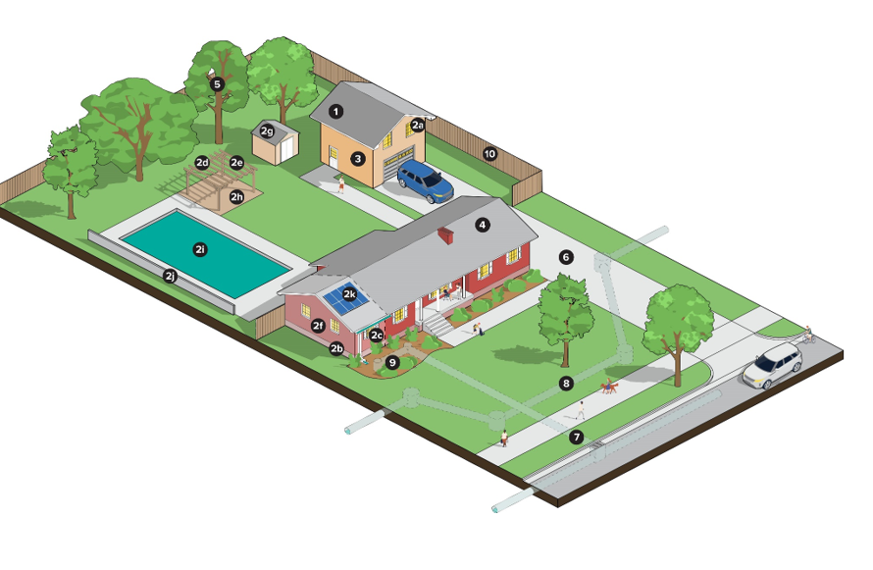
Residential Graphic

Slide 14
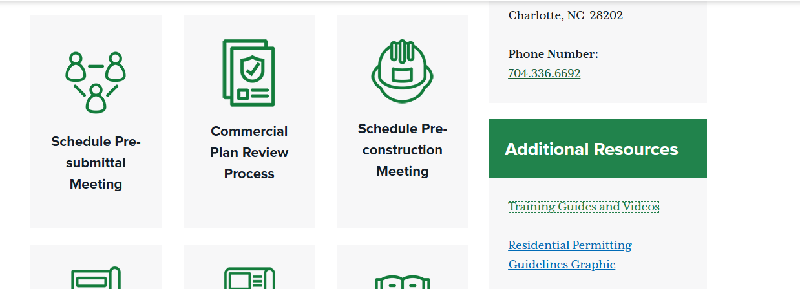
Created a central resource to locate “how-to” guides and training videos. For Plan Room, a series of videos to walk the user through key steps, including how to:
Submit Plans
Locate and Address Issues
Resubmit, When Needed
This resource is designed to provide on-demand support and make the process understandable.

Slide 15
Customer Service

Slide 16
From Our City Manager, Marcus Jones: A Refreshed Vision, Mission and Set of values to guide Team Charlotte (VMV).
Our vision is to be connected, safe and empowered with opportunity for all.
Our mission is to be committed to exceptional service every day.
Our values - who we are - are collaborative, inclusive, trustworthy, reliable and forward thinking.

Slide 17
VMV in action
Using technology to make great customer experiences.
Appointment Kiosk scheduling to assist customers with general and how to questions. The need is evident with the multiple of residential customers we know service via the LDIRL.
Explore “My Bookings” feature on Microsoft to schedule times to meet with a staff meeting via an online booking feature.
Mission Moments: Recognizing staff who give exceptional customer service.
Collaborating with Mecklenburg County to have the submittal process in 2 Accela’s be streamlined and seamless for our customers (work in progress) ☺

Slide 18

Questions

